Slide 1
Graph Theory
—Introductory
Coach: TaoSama

Slide 2
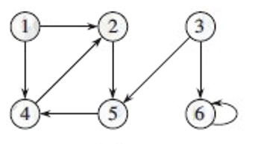
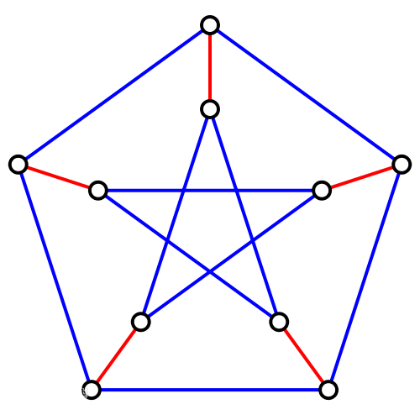
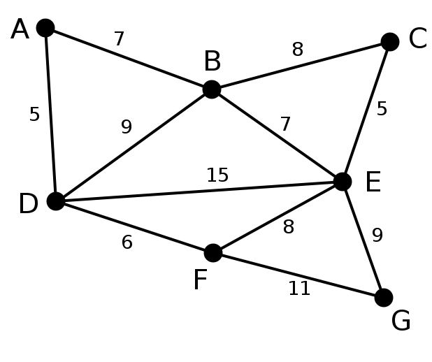
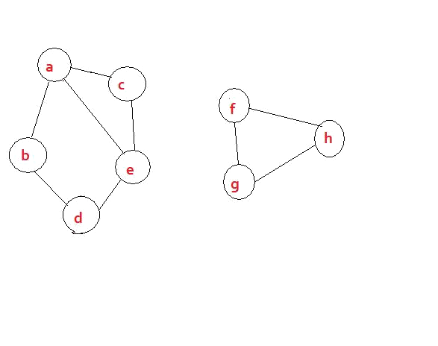
有向？无向？
有权？无权？
连通？非连通？
树？森林？
路径？圈？环？
入度？出度？
Ⅰ. What is Graph？

Slide 3
Ⅱ. How to store a Graph ？
As to a Graph, G = (V, E)
We need to store the V and the E.

Slide 4
Ⅱ. How to store a Graph ？
Representation？
Adjacency-matrix
Adjacency-list
链式前向星（边集数组、静态邻接链表）

Slide 5
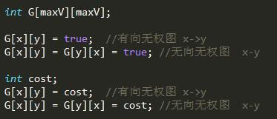
Adjacency-matrix

Slide 6
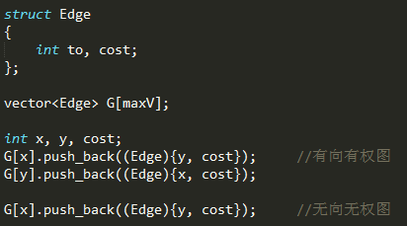
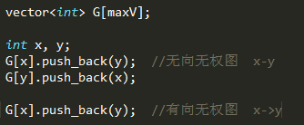
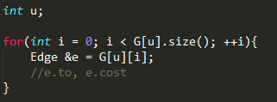
2) Adjacency-list

Slide 7
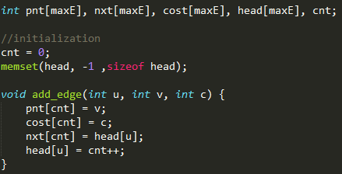
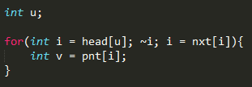
3) 链式前向星

Slide 8
Ⅲ. How to iterate a Graph ？
Dfs
Bfs
Iterate a Tree ？
Pre-Order
In-Order
Post-Order

Slide 9
Ⅳ. Duang~ Come to our Points？
Bellman-Ford
SPFA
Dijkstra
Floyd-Warshall
Shortest path
Minimum spanning tree
Prim
Kruskal

Slide 10
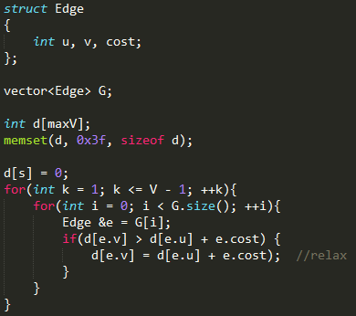
一、Shortest Path
Bellman-Ford
O(VE)

Slide 11
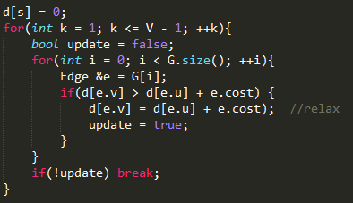
Optimize？
As researched, test with
random data.
1.13|E|
if |E|<|V|
0.95*|E|*log|V|
if |E|>|V|
If found, break the loop.

Slide 12
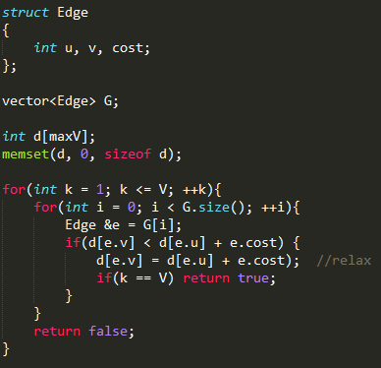
If there exists negative loop？
O(VE)
Find them all!

Slide 13
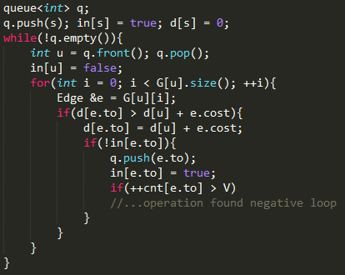
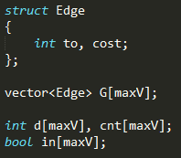
一、Shortest Path
O(kE)？
2) SPFA (Bellman-Ford with queue)

Slide 14
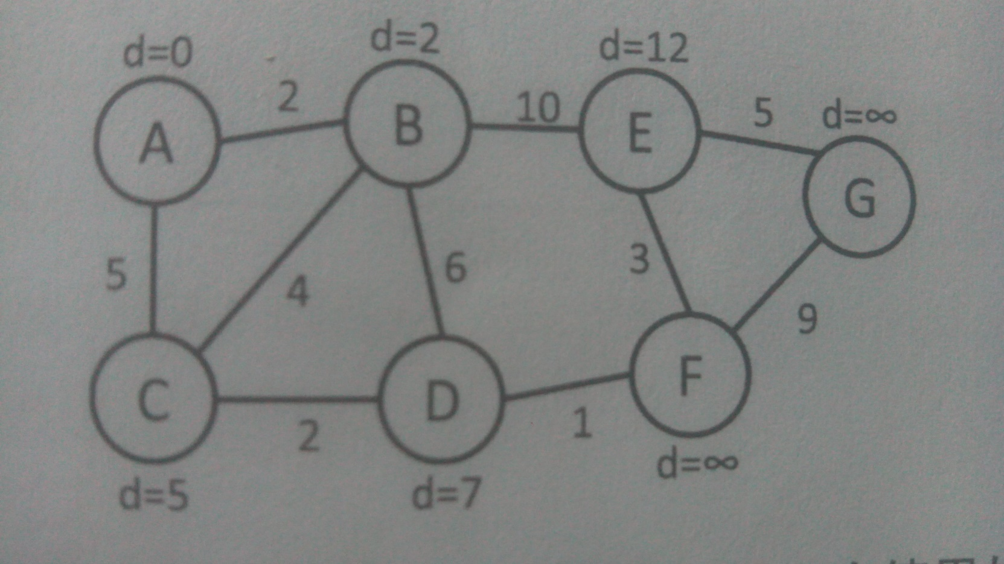
一、Shortest Path
3) Dijkstra

Slide 15
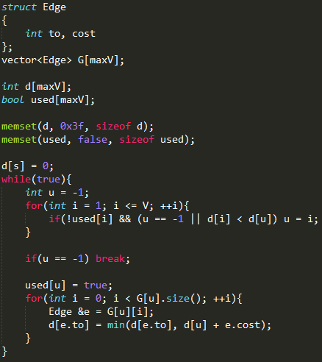
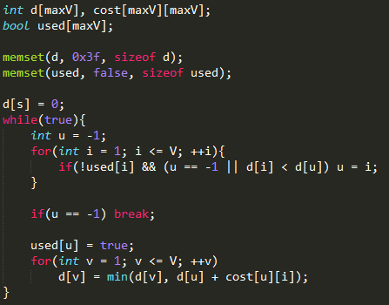
O(V^2 + E) = O(V^2)
>=
O(V*2V) = O(V^2)

Slide 16
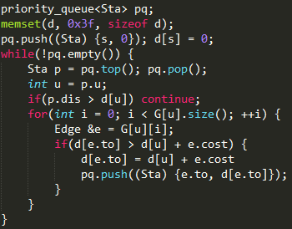
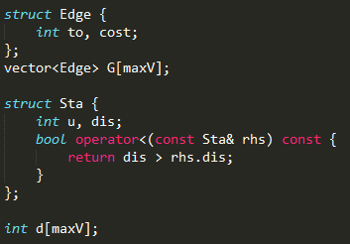
Optimize with minimum heap!
O(ElogV)

Slide 17
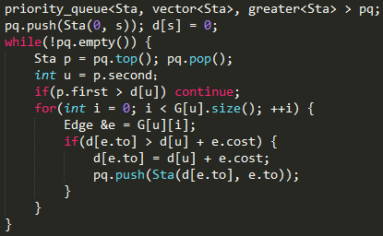
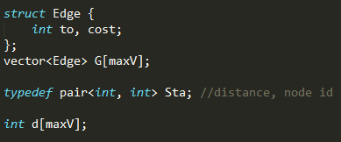
use std::pair !

Slide 18
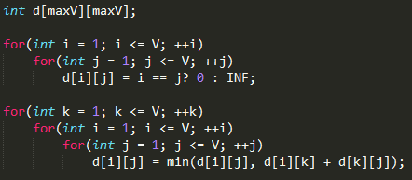
一、Shortest Path
4) Floyd-Warshall
O(V^3)

Slide 19
例题选讲
次短路
某街区有R条道路，N个路口，道路双向通行，问1号路口到N号路口的次短路长度是多少？
次短路是指比最短路道路长的次短路径。
1<= N <= 5000
1<= R <= 10^5

Slide 20
例题选讲
POJ 1932 XYZZY
有N个房间，每到达一个房间会获得或者减少体力值，
初始位于1号房间，拥有100点体力值，房间可以重复通过来获取体力值。到达某个房间的体力值必须大于0才能获取当前房间的体力值
1 <= N <= 100

Slide 21
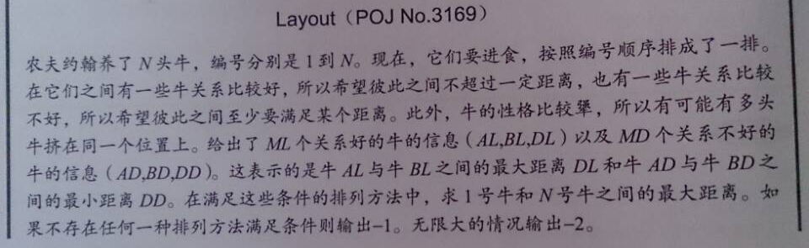
例题选讲
Differential Constraints
2 <= N <= 1000
1 <= ML, MD <= 10000
1 <= AL < BL <= N
1 <= AD < BD <= N
1 <= DL, DD <= 10^6

Slide 22
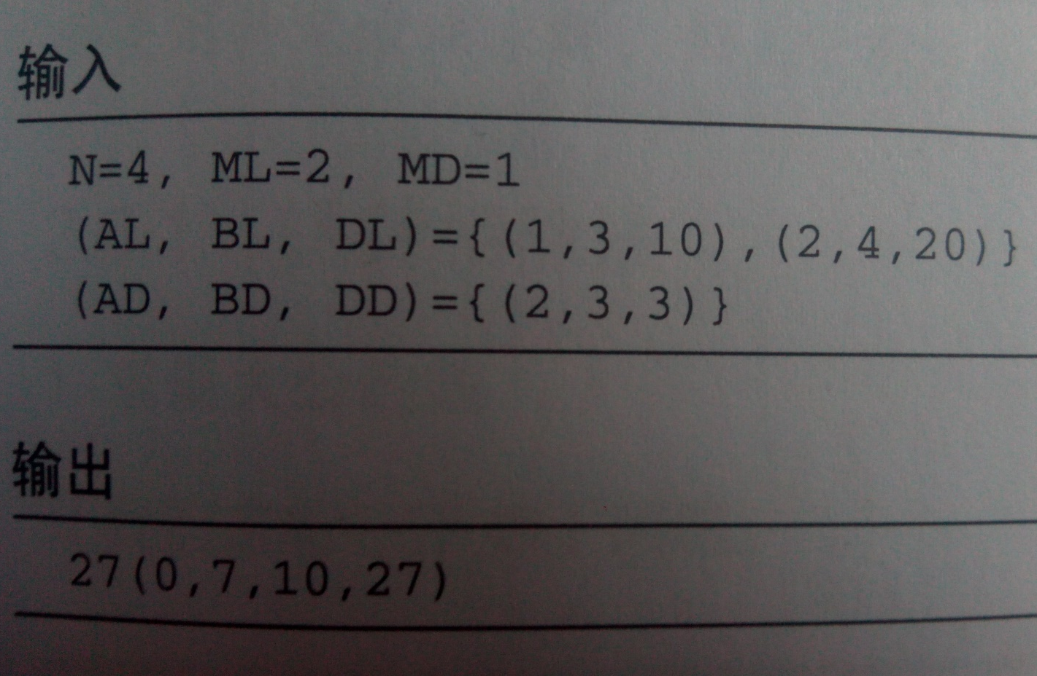
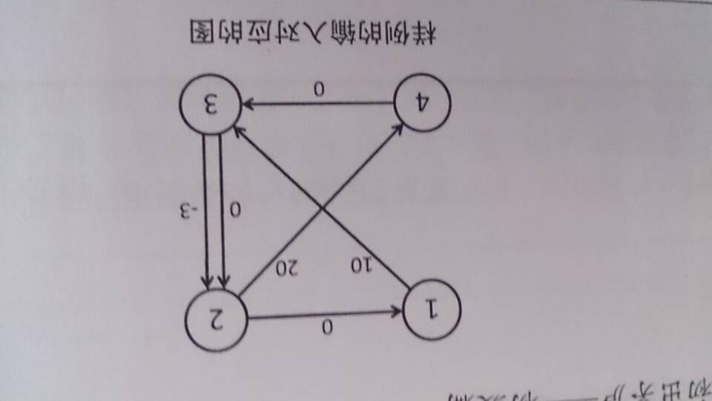
Differential Constraints

Slide 23
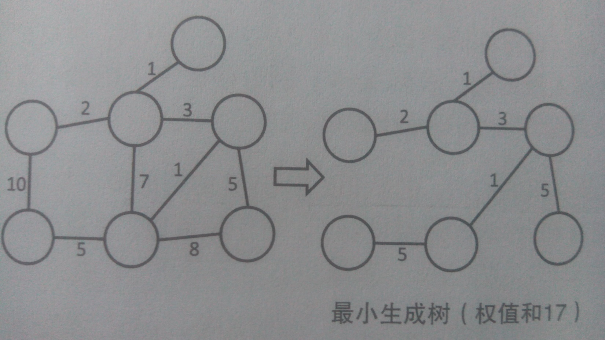
二、Minimum Spanning Tree
1) Prim

Slide 24
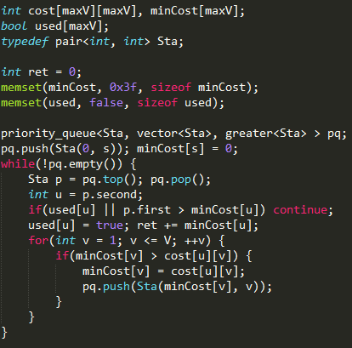
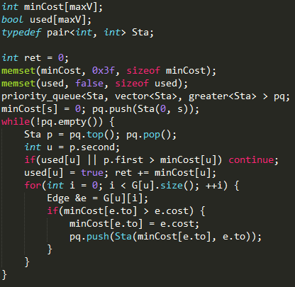
O(V^2logV)
>=
O(ElogV)

Slide 25
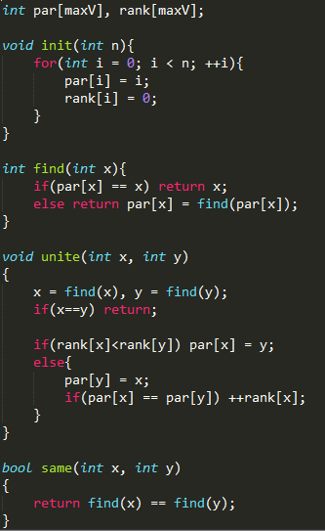
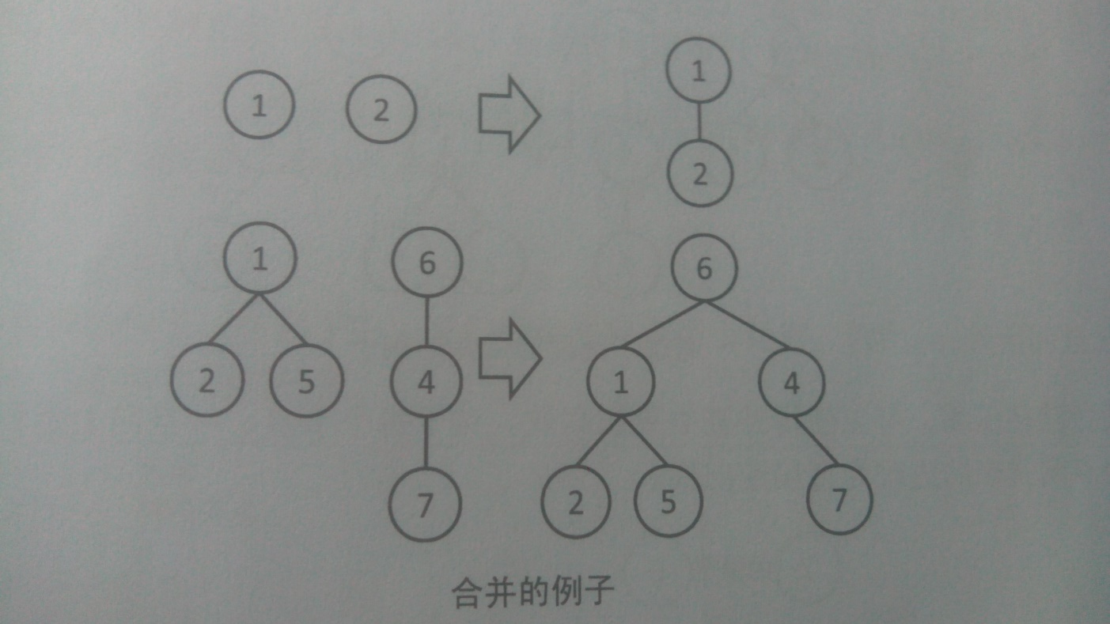
二、Minimum Spanning Tree
2) Kruskal
O(α(n) )

Slide 26
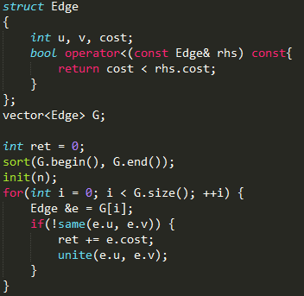
O(ElogE + ElogV)

Slide 27
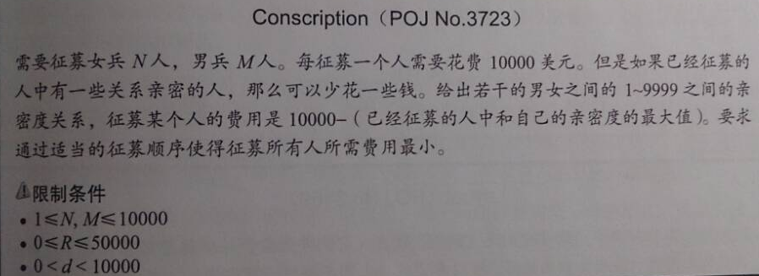
例题选讲
Maximum Spanning Forest

Slide 28

祝诸君武运昌隆！

